Slide 1
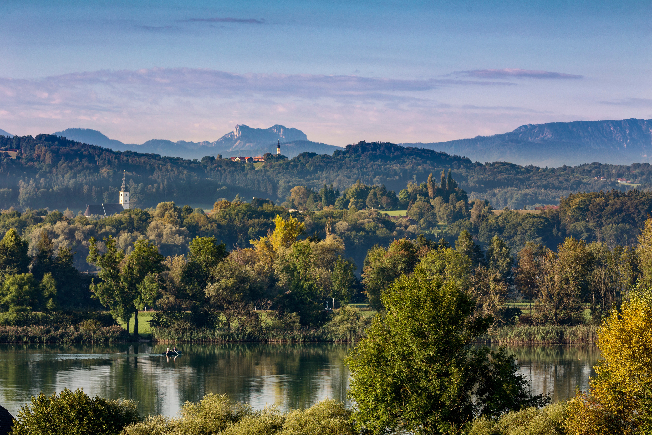
ALLIANCE IN THE ALPS
08.10.2025
JOINT SUSTAINABLE PROCUREMENT
EXPERIENCES FROM
ILE ZUKUNFTSREGION RUPERTIWINKEL

Slide 2

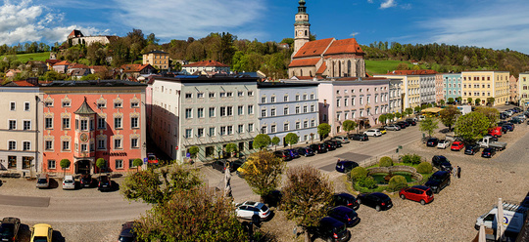
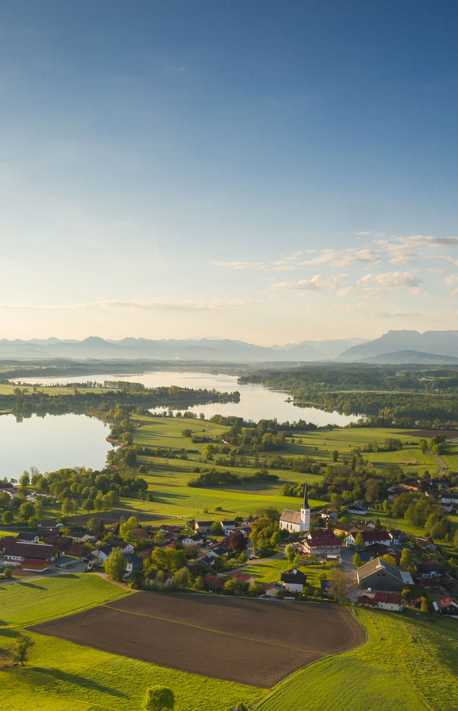

TABLE OF
CONTENT
ILE ZUKUNFTSREGION RUPERTIWINKEL
SHOP RUPERTIWINKEL
MUNICIPAL DEVELOPMENT POLICY
QUESTIONS

Slide 3
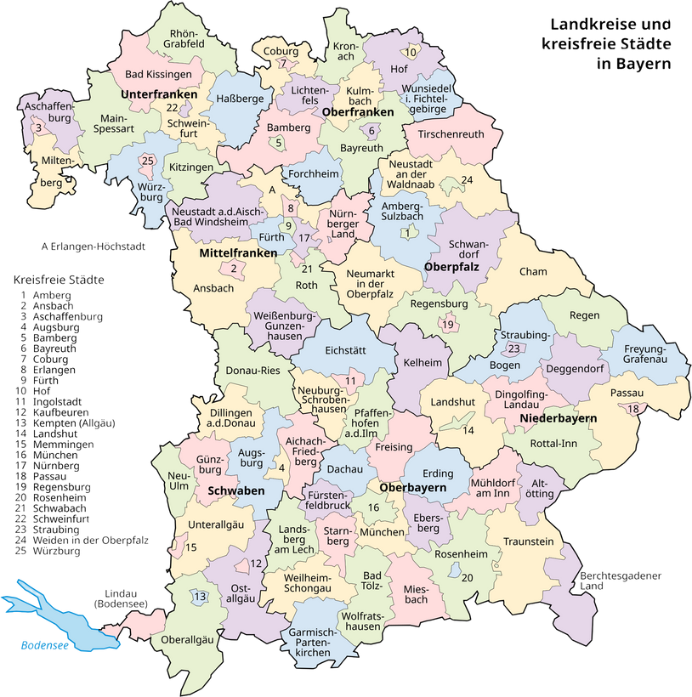
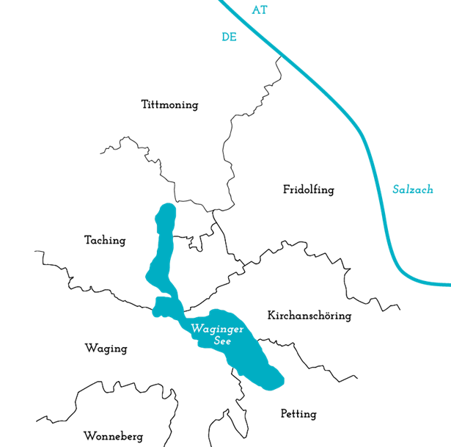

THE ILE ZUKUNFTSREGION RUPERTIWINKEL
COLLABORATION
of seven municipalities in Rupertiwinkel (since 2015)
→ Joint implementation of ecological, social and economic projects
→ Pooling of resources
→ Promotion of professional implementation management
Professionally supervised by the Office for Rural Development, funded by the Bavarian State Ministry for Food, Agriculture, Forestry and Tourism

Slide 4
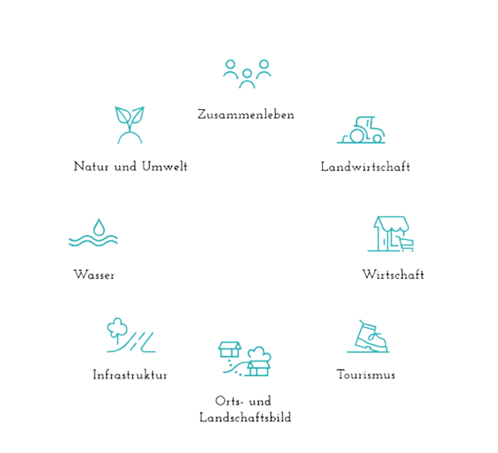
AREAS OF ACTION
LIVING TOGETHER
NATURE & ENVIRONMENT
AGRICULTURE
WATER
ECONOMY
INFRASTRUCTURE
TOURISM
VILLAGE & LANSCAPE IMAGE

Slide 5

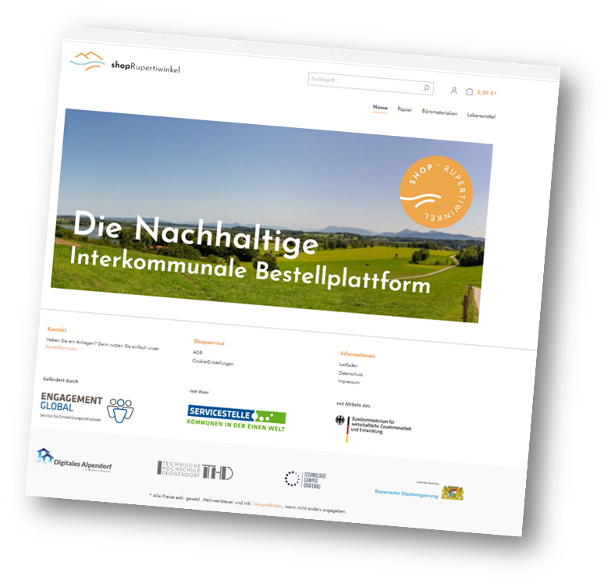
THE SUSTAINABLE
ORDERING PLATFORM:
SHOP RUPERTIWINKEL
OBJECTIVES
Relief for municipalities through intermunicipal procurement pooling
  Simplification of procurement procedures
  Legal certainty through procurement legal advice
  Economization through larger order volumes
  Sustainable, eco-fair and regional value creation
→ Municipalities have great market power as buyers
→ Educational work: Creating awareness among citizens

Slide 6

DEVELOPMENT OF THE ORDERING PLATFORM
IDEA OF A JOINT SHOP
CONCEPT DEVELOPMENT “DIGITALES ALPENDORF
Development of the concept "Sustainable intermunicipal ordering platform" as part of of the Projekt “Digitales Alpendorf” with the Technology Campus Grafenau
START KEPOL PROJECT 2022
Funding of a staff position to establish Shop Rupertiwinkel
KICK-OFF EVENT
Sensitization of administrations to sustainable procurement and determination of the first product group: copy paper
NEEDS ASSESSMENT
Determination of concrete needs and special requirements
PROCUREMENT PROCESS
with support from sustainability experts Dietmar Lenz and Vivien Führ
IMPLEMENTATION OF THE FIRST PRODUCT GROUP

Slide 7
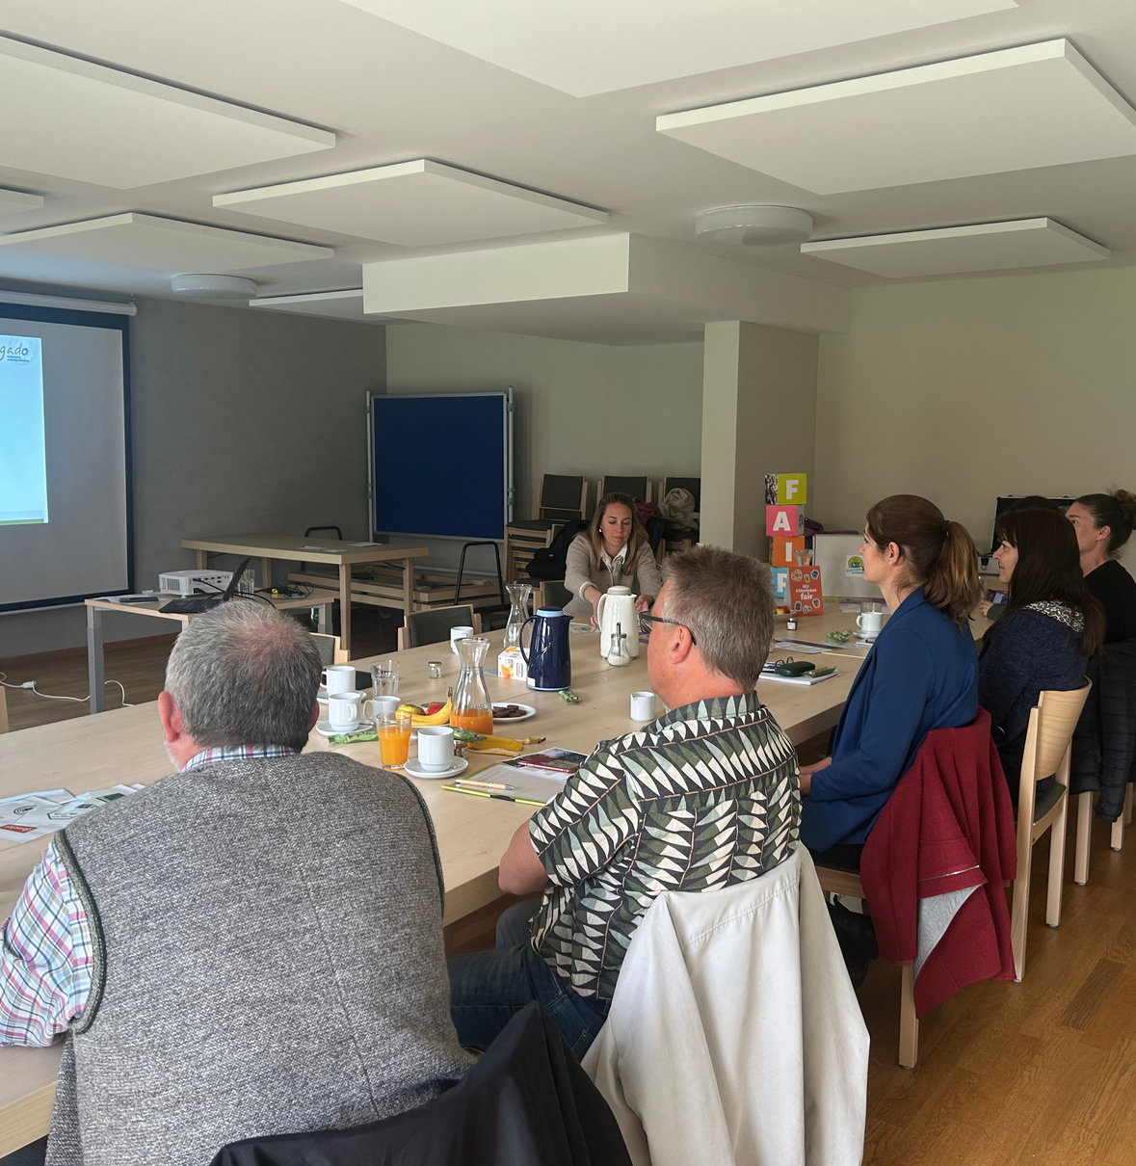
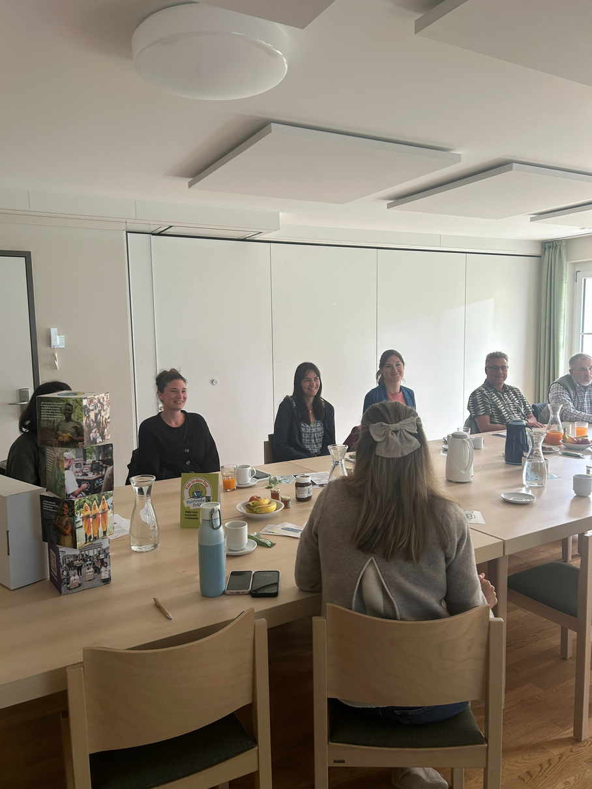

CHALLENGES
& SUCCESS FACTORS
  Fear of loss of competence
  Uncertainty about change
  Tension between regional and fair procurement
  Lack of transparency in sustainability labels
  Existing prejudices and negative experiences
PARTICIPATORY APPROACH

Slide 8

COOPERATIONS & FUNDING
DIGITALES ALPENDORF
Funding of digitalization measures in the ILE region by the Bavarian Ministry of Economic Affairs
→ Development of the Rupertiwinkel shop by the Technology Campus Grafenau
Funding level 75%, completed 2023
COORDINATION MUNICIPAL
DEVELOPMENT POLICY (KEPOL)
Funding of a staff position as well as budget for accompanying measures by the Service Agency Communities in One World (SKEW) (Engagement Global)
→ Staff position for building up the shop
→ Support from procurement experts Dietmar Lenz and Vivien Führ Funding level 90%, since 2025 75%
Processing via the municipality of Kirchanschöring

Slide 9
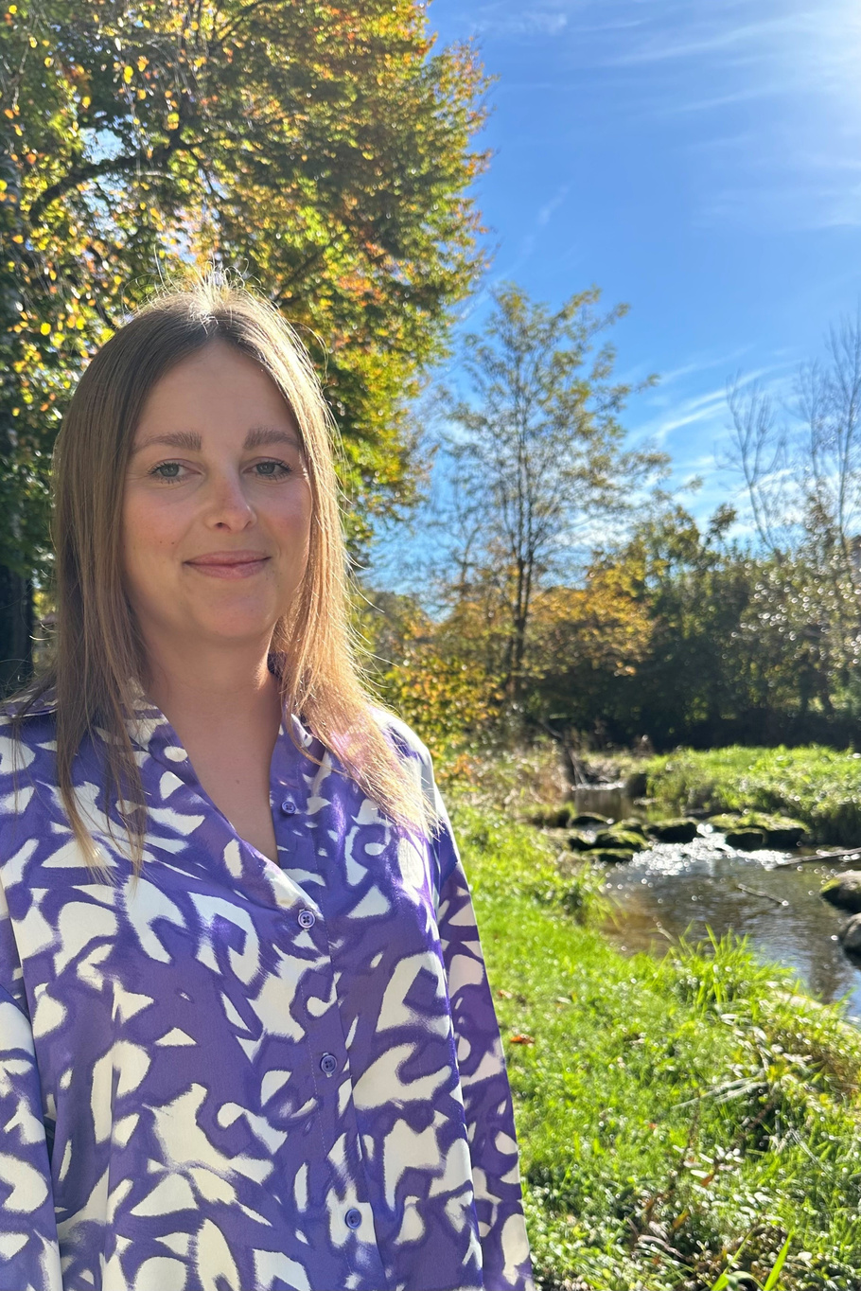
MUNICIPAL DEVELOPMENT POLICY IN THE ILE REGION
SUSTAINABLE PROCUREMENT
FAIRTRADE
PARTNERSHIP
Since July 9th, the ILE can call itself the first region in Upper Bavaria to be a "Fairtrade Region."
Since June 2024, there is a solidarity partnership between the ILE region and Horokhiv in Ukraine.
In Shop Rupertiwinkel, municipalities can order sustainable products.

Slide 10
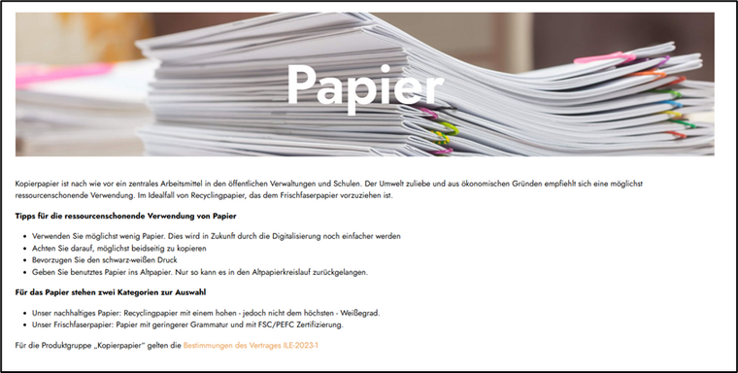

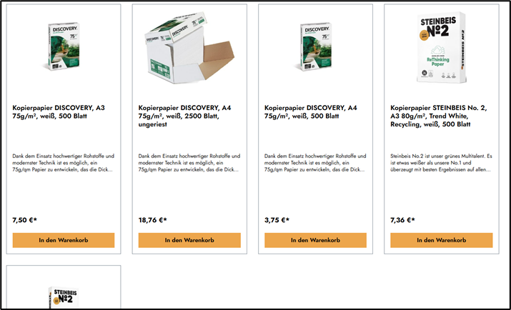
THE SHOP
COPY PAPER AND HYGIENE PAPER
INTEGRATION OF THE SUSTAINABILITY COMPASS
SUPPORT BY KEPOL POSITION IN COOPERATION WITH EXPERTS

Slide 11

CURRENT NEWS & OUTLOOK
New framework conditions: Change in procurement thresholds since 01.01.2025
→ SIMPLIFICATION OF THE PROCUREMENT PROCESS
  Next product groups: Office supplies & cleaning supplies
  Working committee of administrative staff
  Creation of a guide for direct procurement
Goal: Administrations are independently able to add new products to the shop

Slide 12



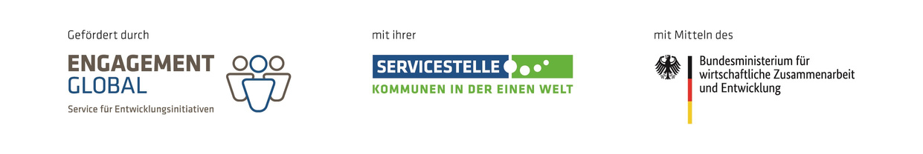
CONNECT
WITH US
+49 1514 2074832
lisa.seehuber@zukunftsregion-rupertiwinkel.bayern
www.zukunftsregion-rupertiwinkel.bayern
@zukunftsregion_rupertiwinkel

